Slide 1
Interpolation & Optimization Computer Vision (UW EE/CSE 576)
Richard Szeliski
Facebook & UW
Lecture 5 – Apr 14, 2020

Slide 2
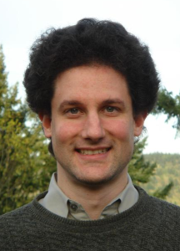


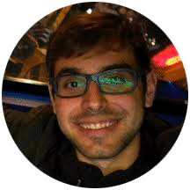


Computer Vision (EE/CSE 576)
Instr.s
TAs
Slides are online here (calendar tab):
http://www.cs.washington.edu/education/courses/cse576/20sp/
Steve Seitz
Rick Szeliski
Harpreet Sawhney
Aleksander Holynski
Keunhong Park
Svet Kolev

Slide 3
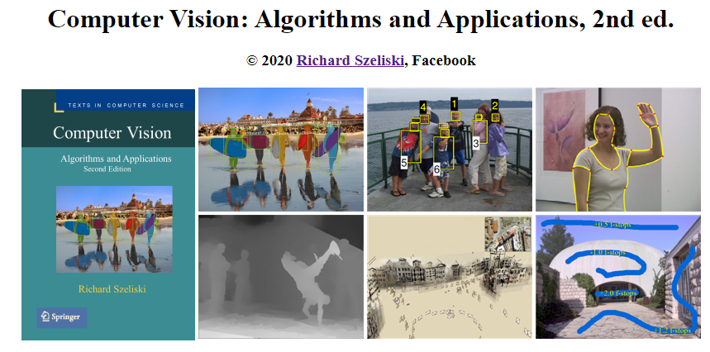
Rick’s book
http://szeliski.org/Book/2ndEdition.htm
Notes:
Please remember to send me comments and suggestions

Slide 4
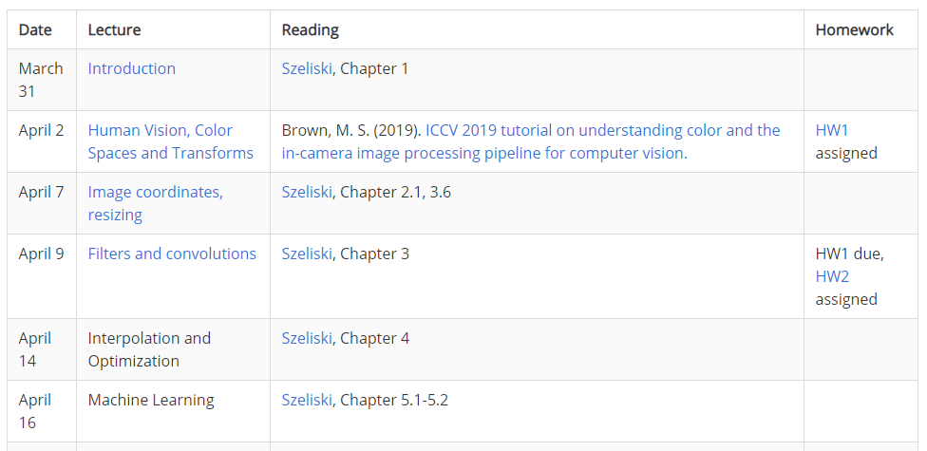
Class calendar

Slide 5
Filtering, resampling, pyramids, blending
Linear and separable filtering
Non-linear filtering
De-noising and tone adjustment
Pyramids
Blending
Resampling (rotations, etc.)
Regularization and Markov Random Fields
Assignments: Laplacian pyramid blending
Notes:
This slide set was derived from a longer lecture that starts with the basics of image processing and covers all of Chapters 3 & 4 in Szeliski 2nd edition.
The slides not used in UW CSE 576 (since the material was already covered in Lectures 3-4 by Steve Seitz) are hidden.

Slide 6
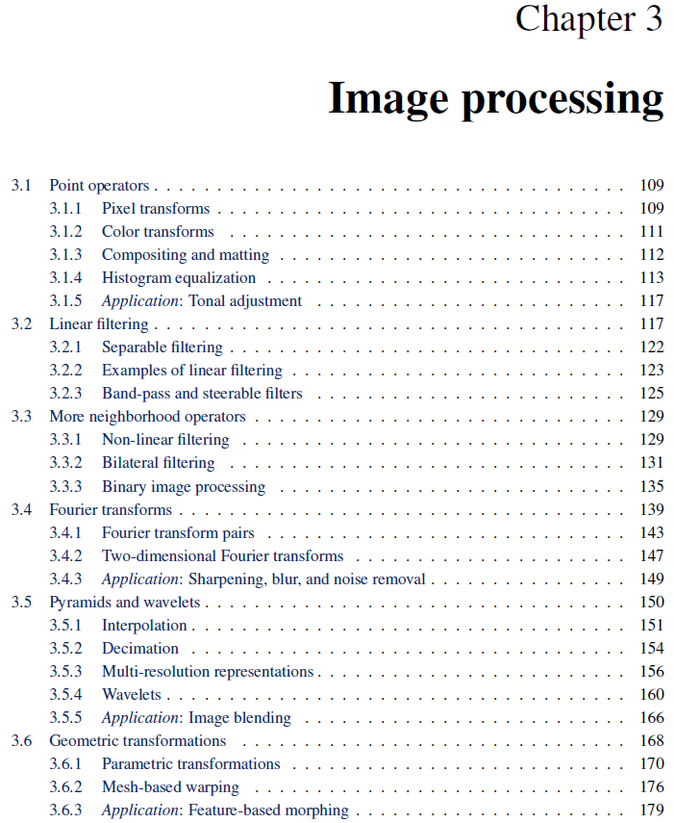
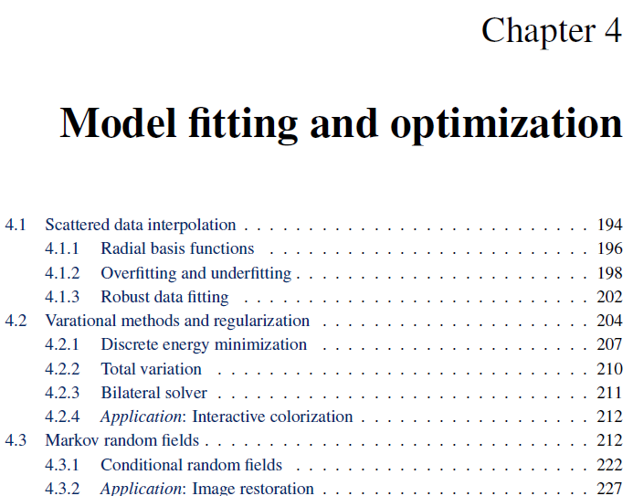
References

Slide 7
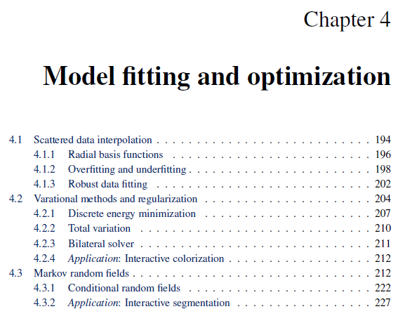
Readings

Slide 8
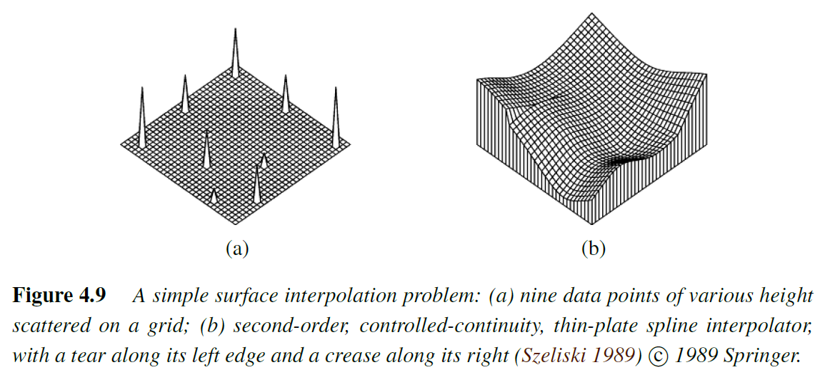
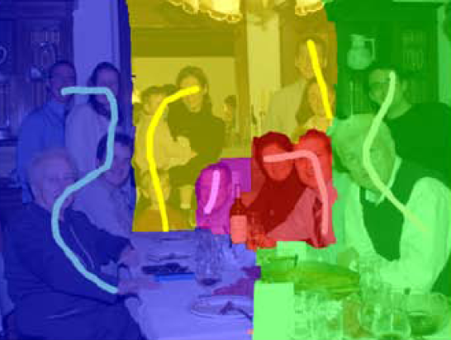
Interpolation and optimization
Interpolation
Pyramids
Blending
Resampling (rotations, etc.)
Data Fitting
Regularization and variational techniques
Markov Random Fields
Notes:
This is the actual content of Lecture 5 for CSE 576

Slide 9
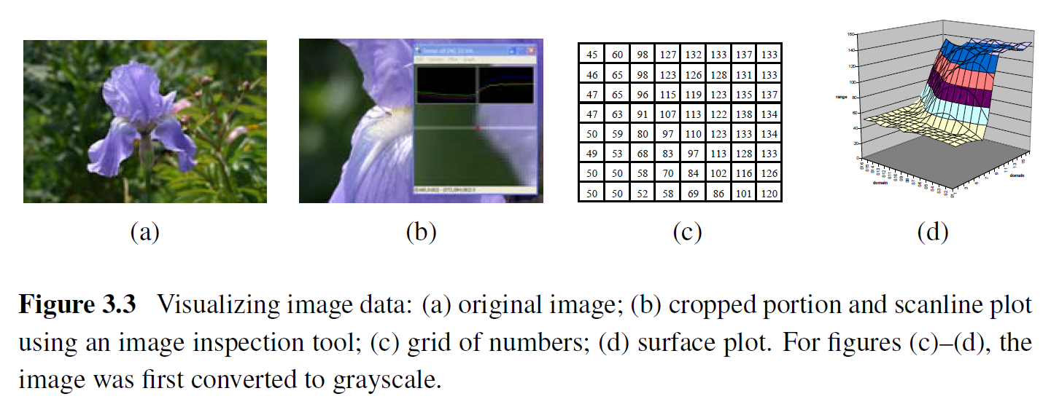
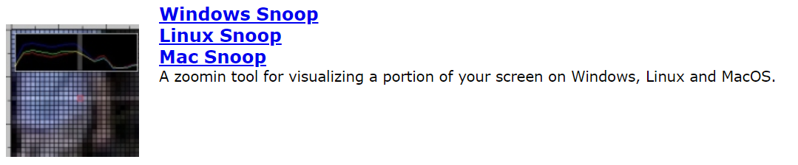
What are images?
Snoop is awesome! https://www.csie.ntu.edu.tw/~cyy/projects/index.html

Slide 10
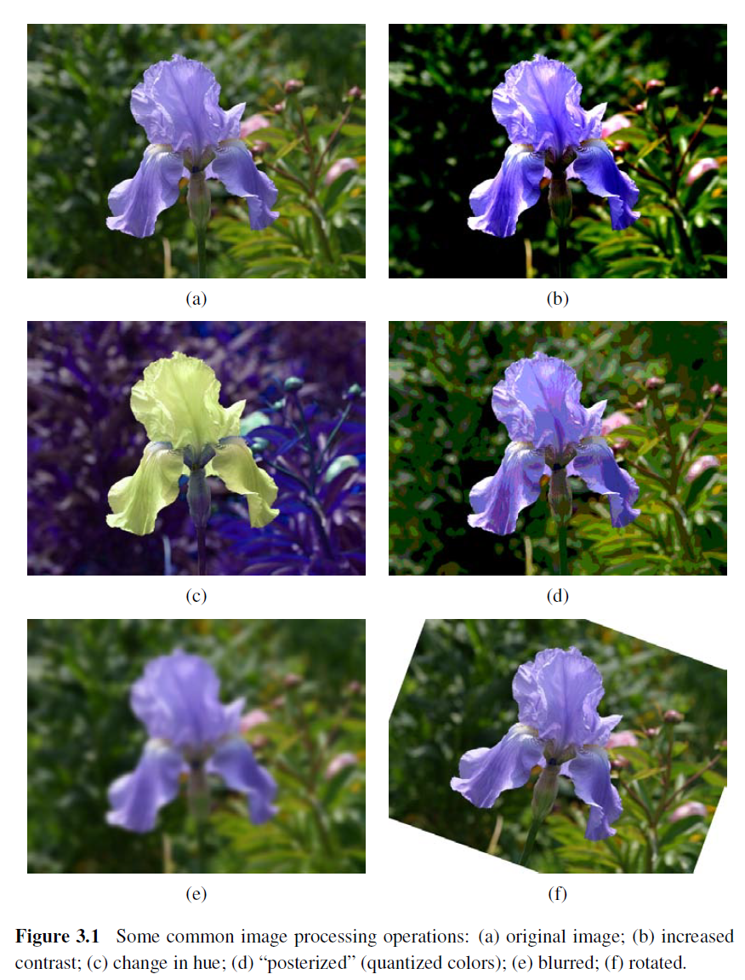
Common operations

Slide 11
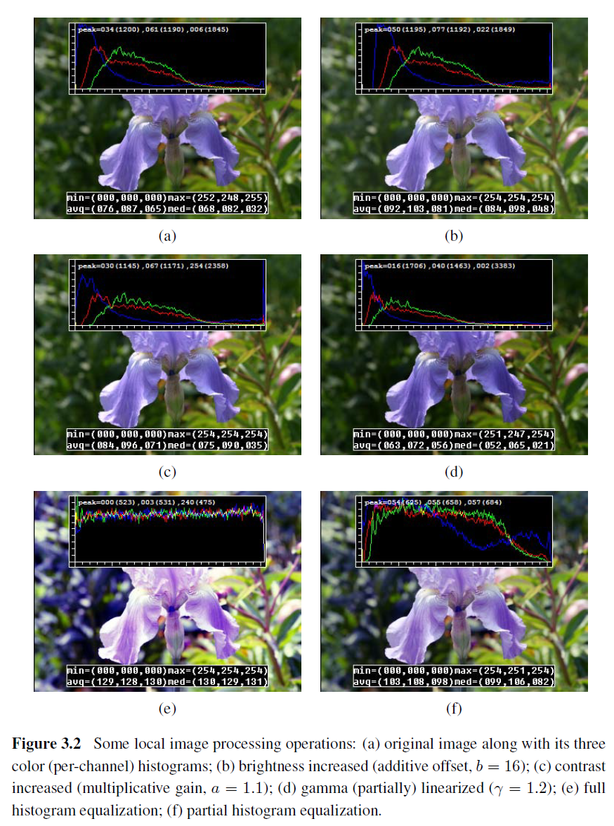
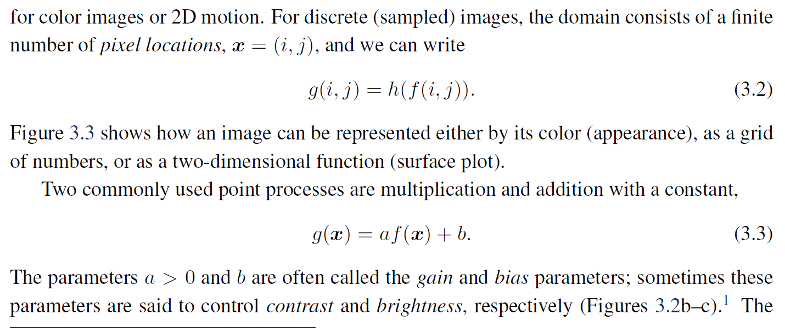
Local (point-wise) operations

Slide 12
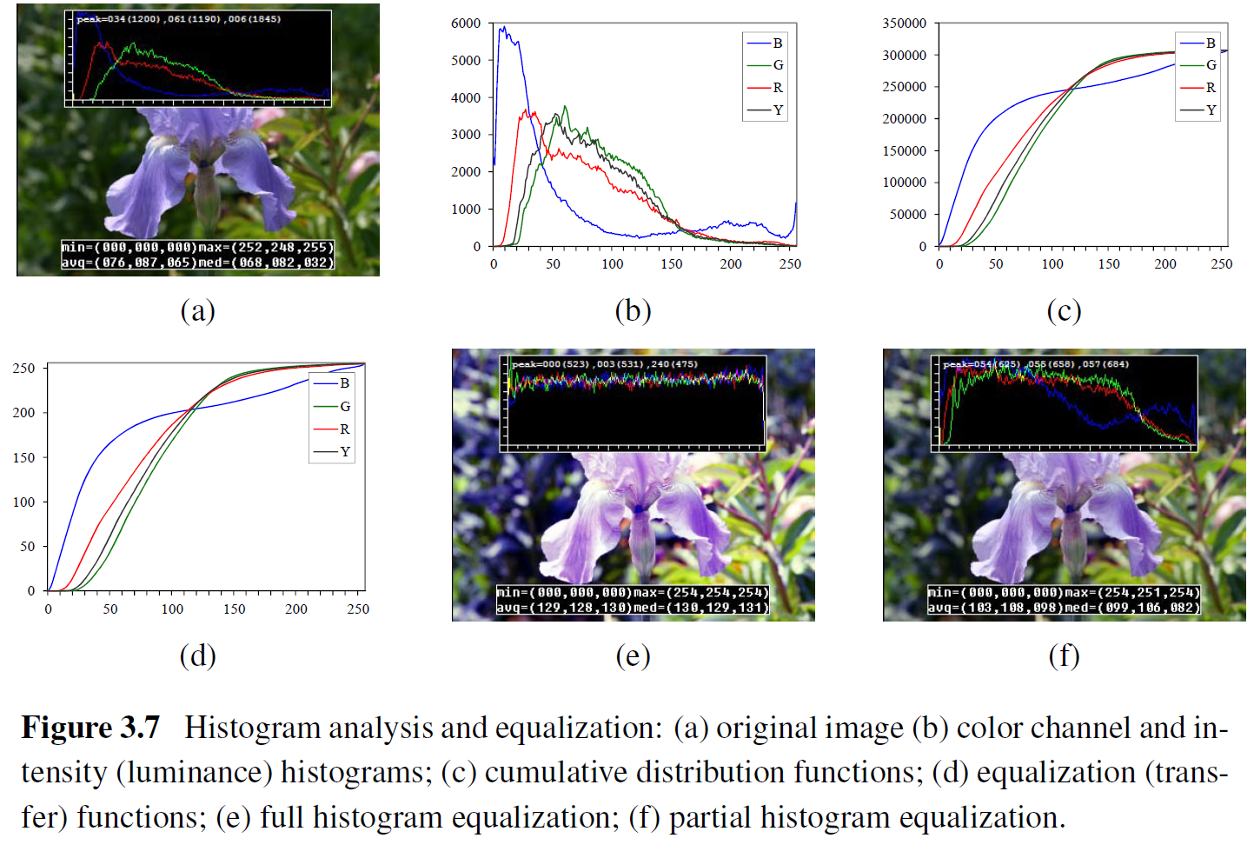
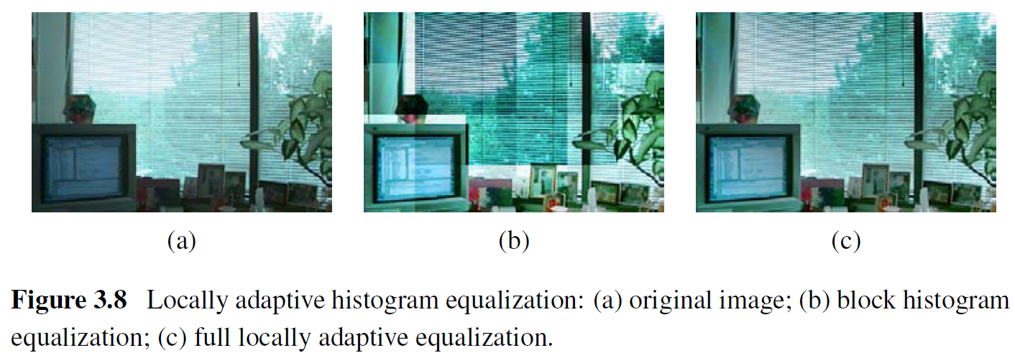
Histogram equalization

Slide 13
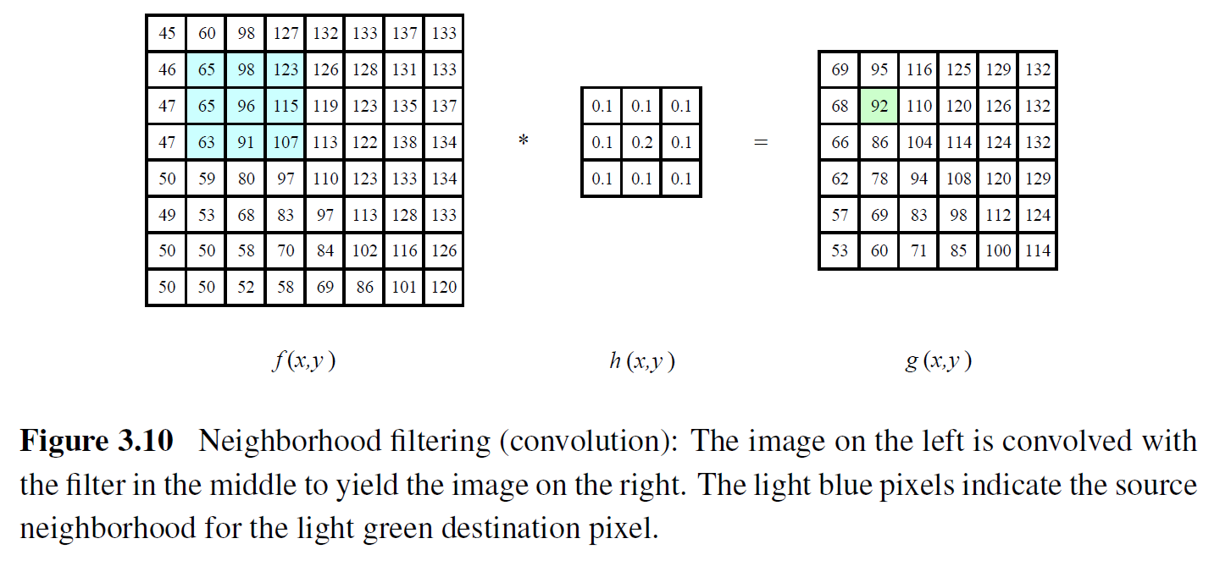
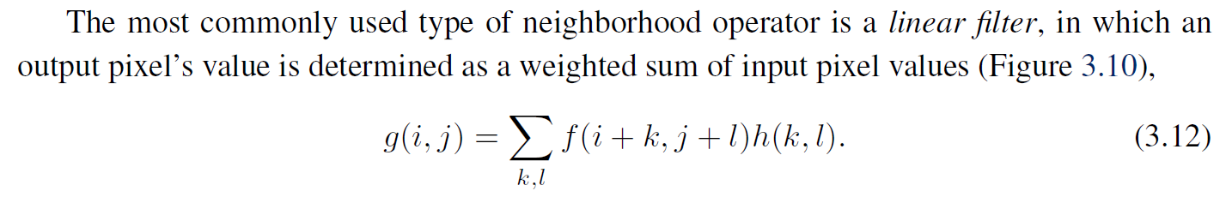
Linear filtering (convolution)

Slide 14
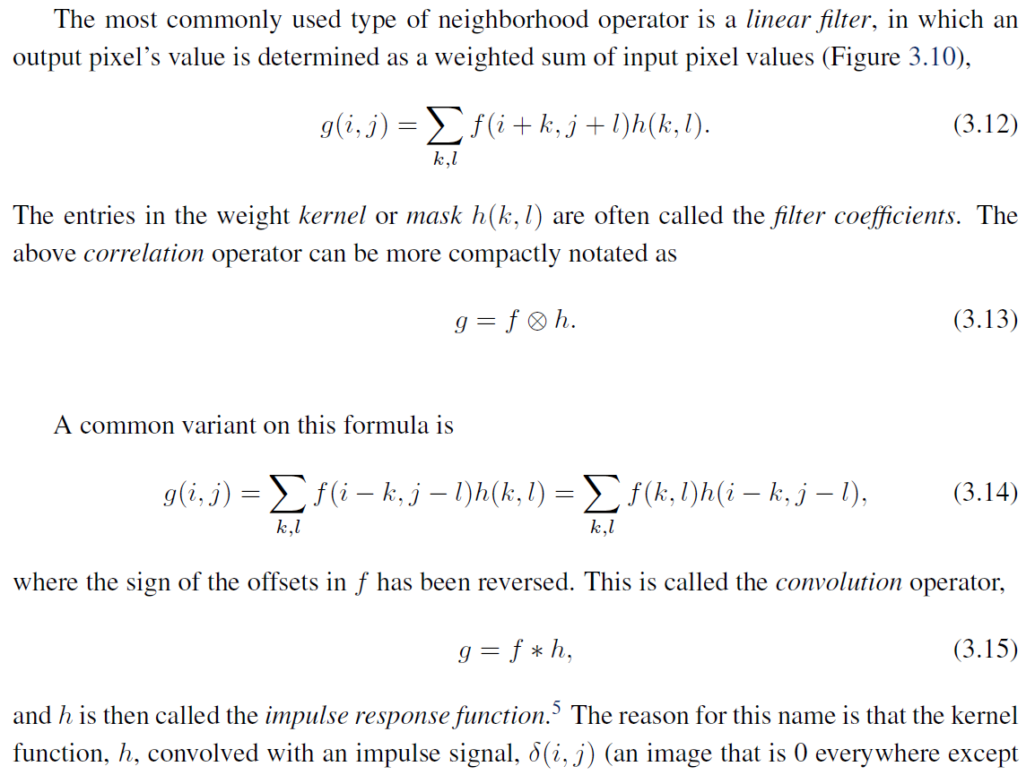
Correlation vs. convolution

Slide 15
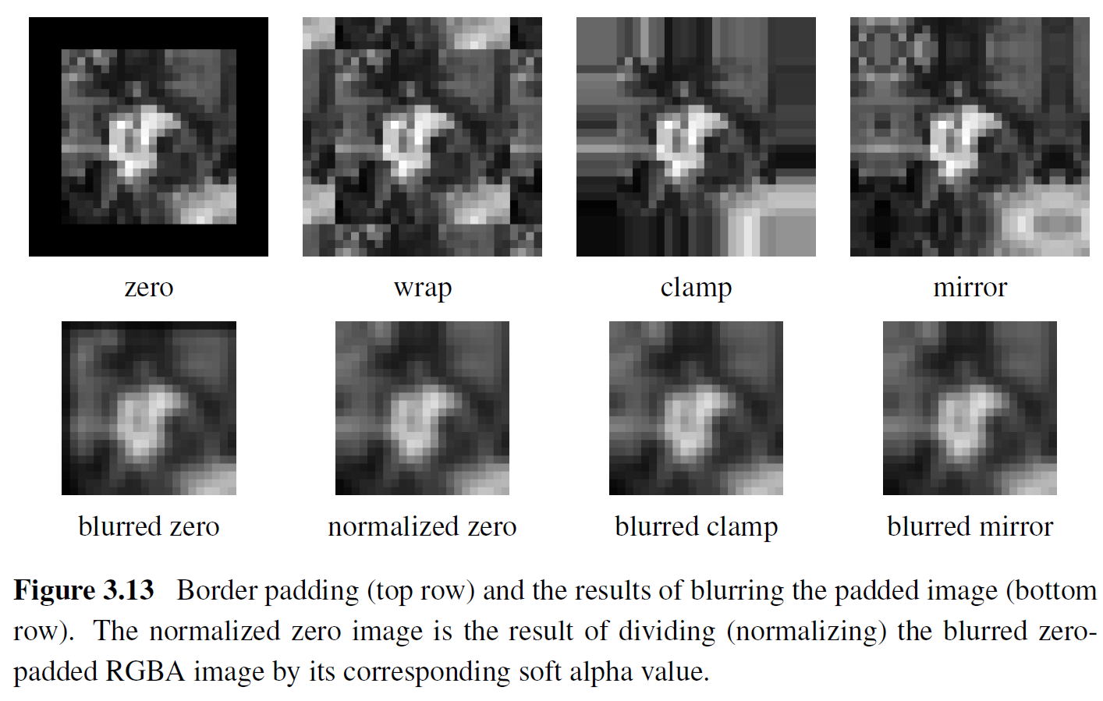
Border padding

Slide 16
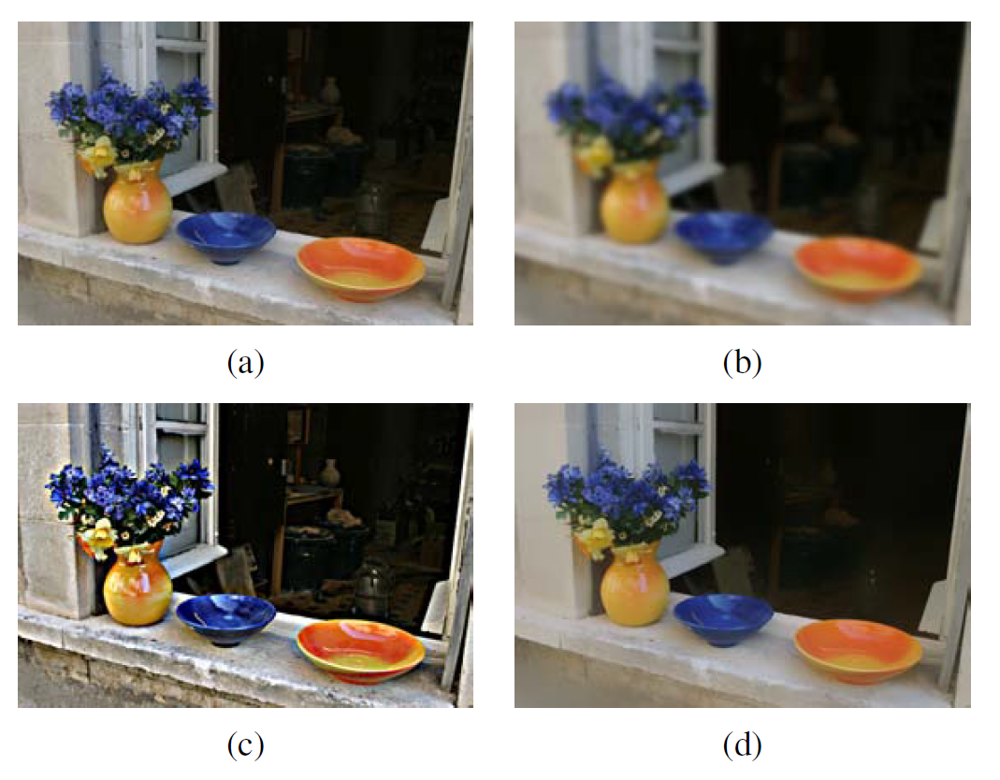
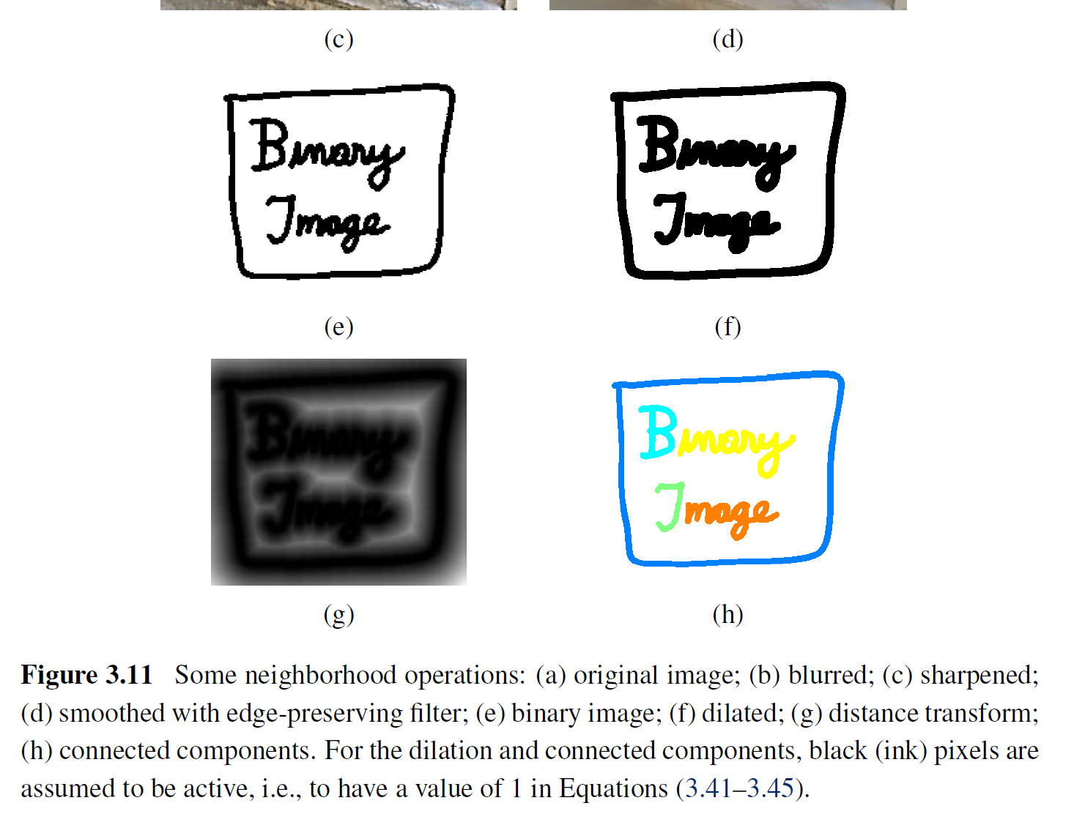
Filtering examples

Slide 17
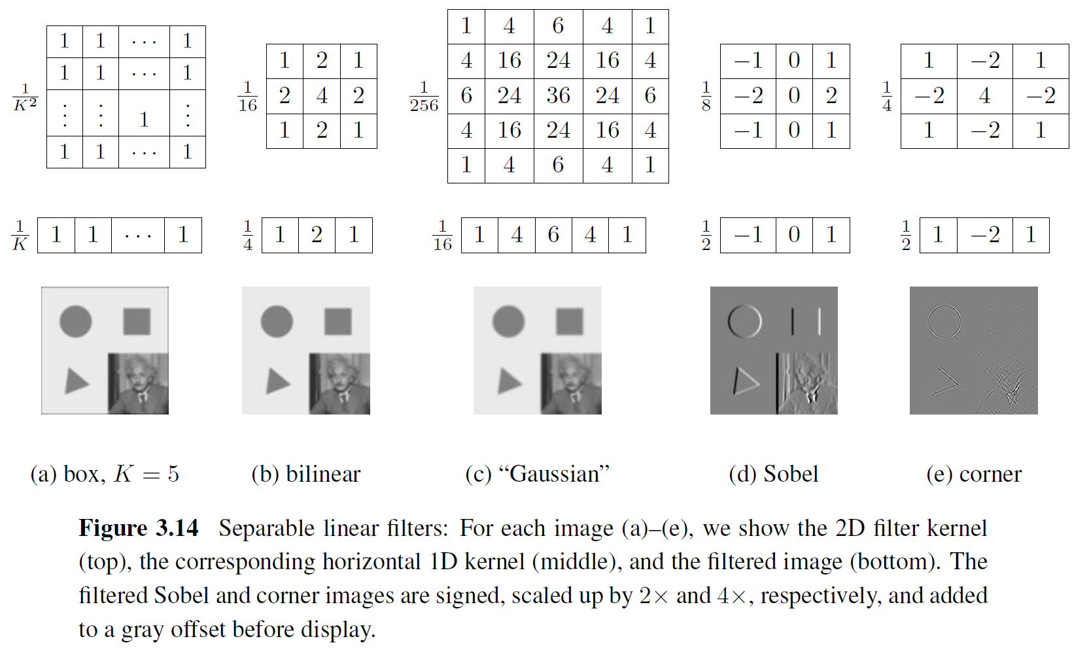
Separable filters (more efficient)

Slide 18
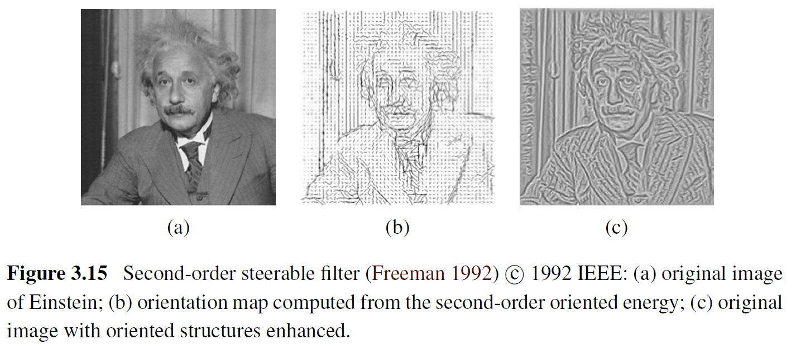
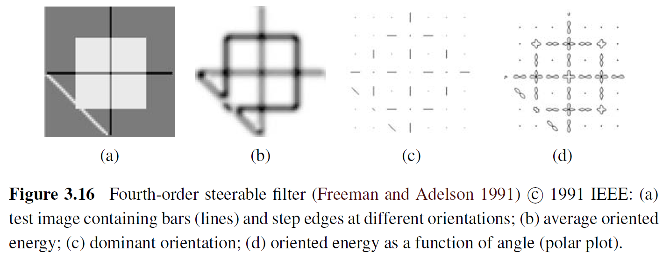
Steerable oriented filters

Slide 19
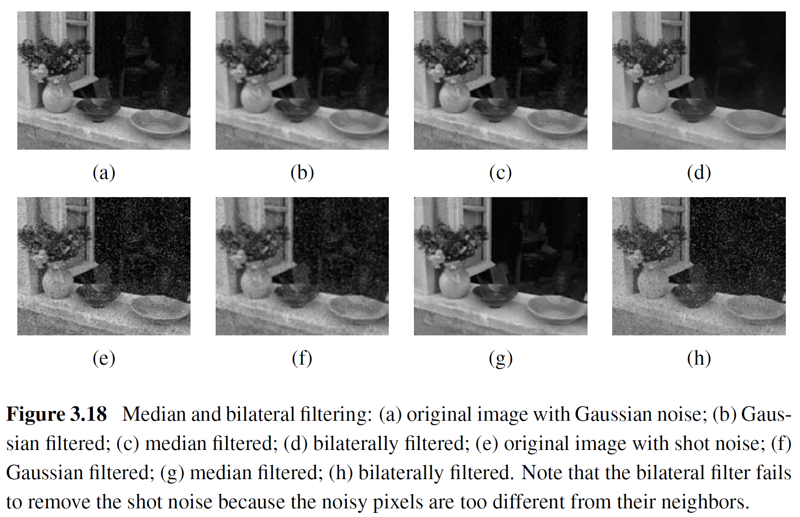
Non-linear denoising filters

Slide 20
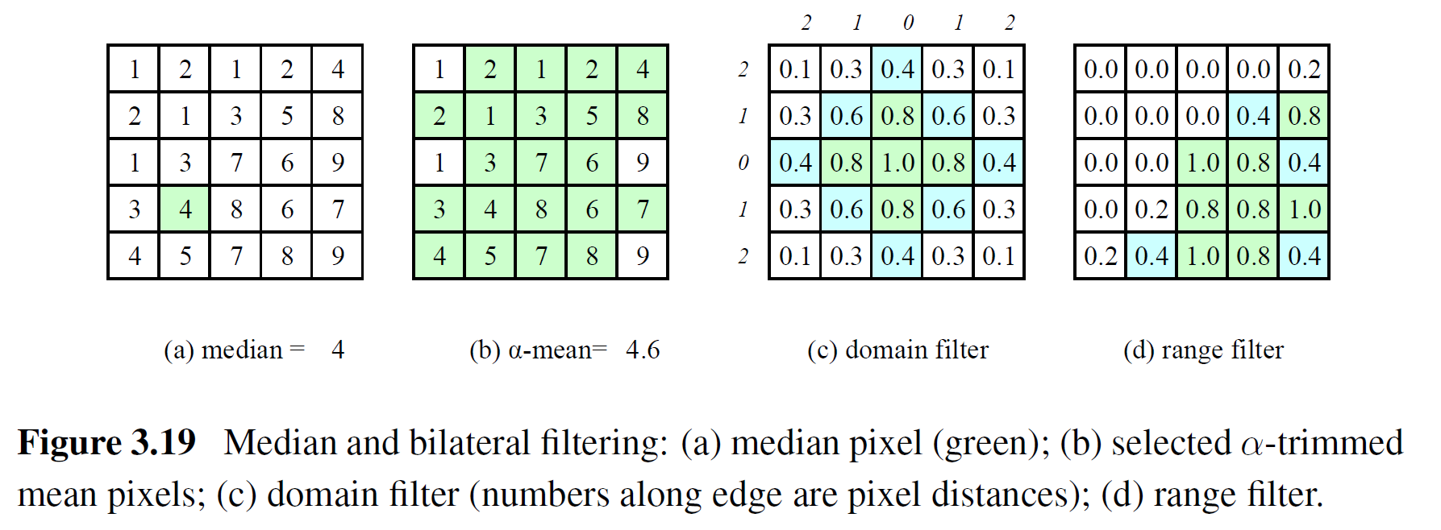
Non-linear denoising filters

Slide 21
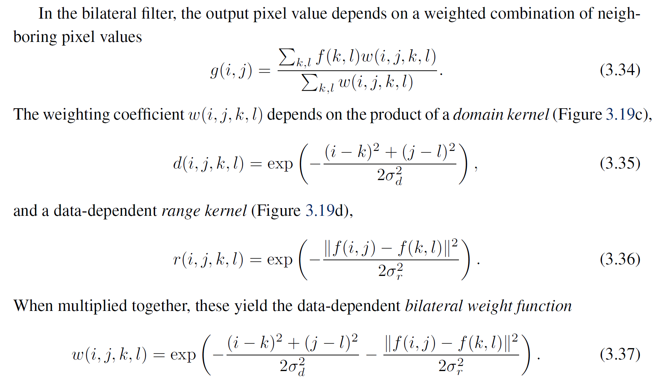
Bilateral filter

Slide 22
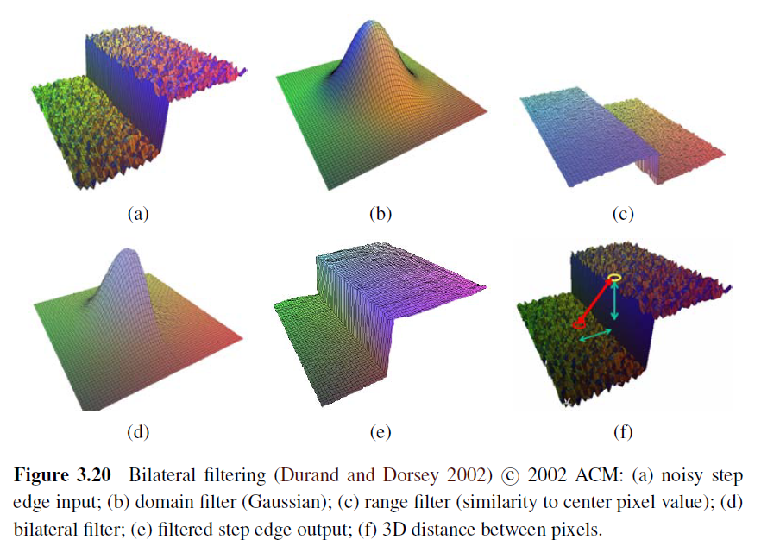
Bilateral filter

Slide 23
Other neighborhood operations

Slide 24
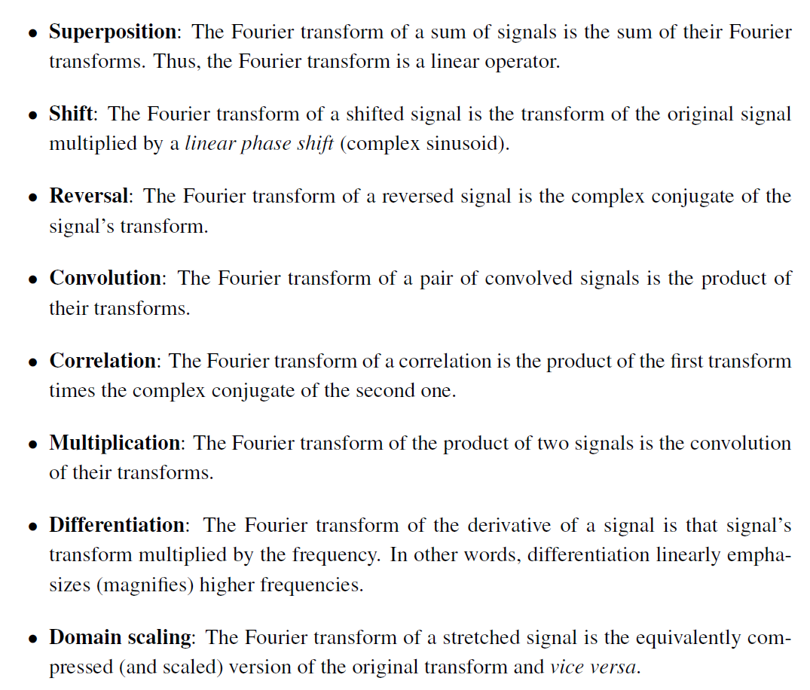
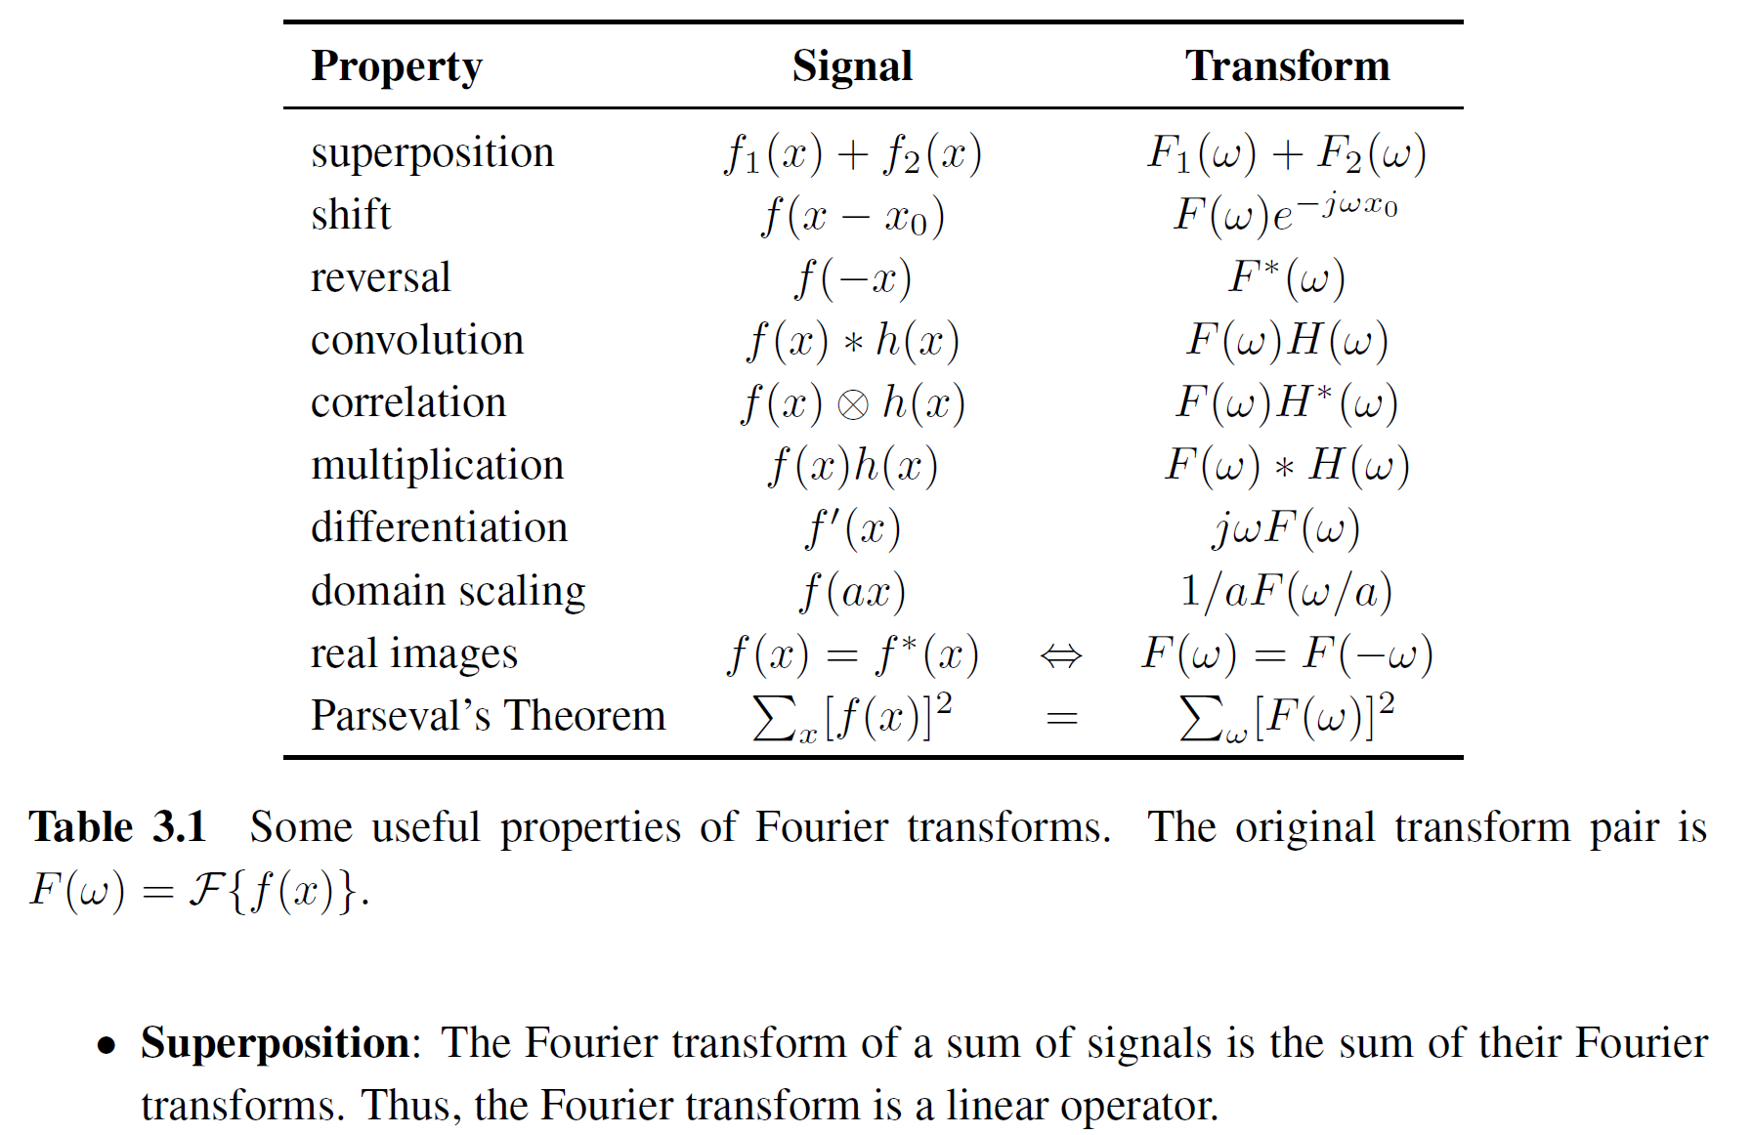
Fourier transforms
Q: what’s their main advantage?

Slide 25
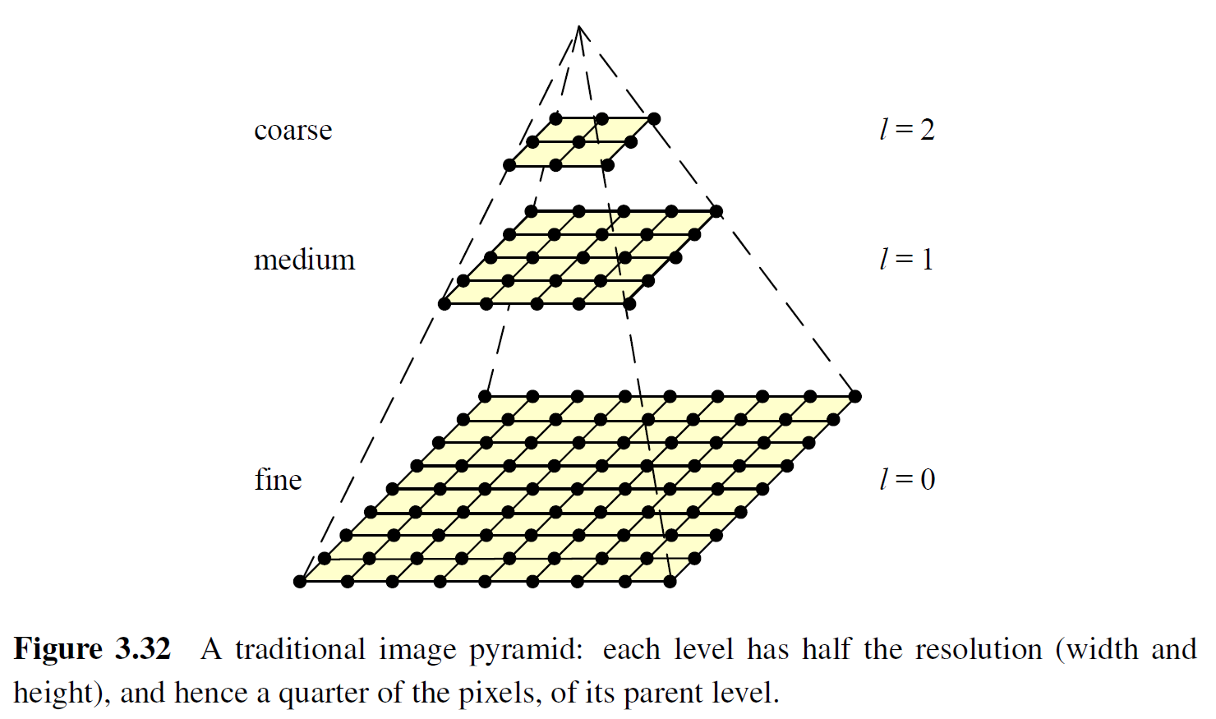
Pyramids and wavelets
Interpolation: scaling up
Decimation: scaling down
Image pyramids
(Invertible) difference pyramids
Wavelets

Slide 26
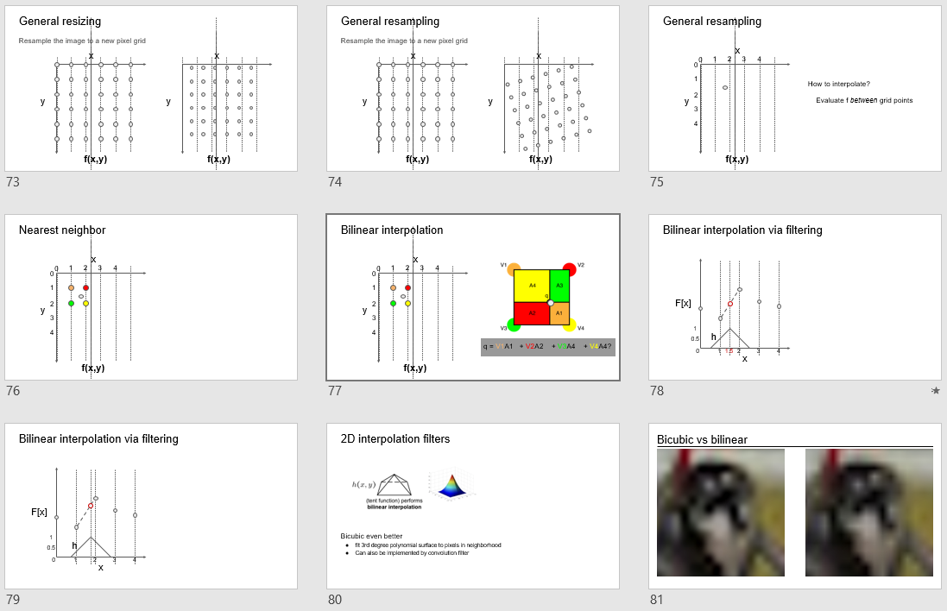
Recall from previous lecture

Slide 27
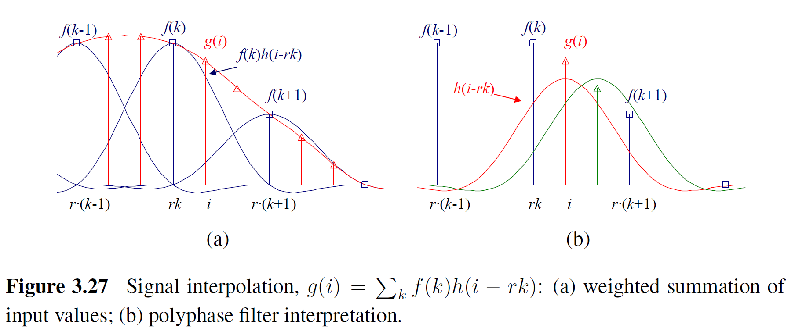
Interpolation

Slide 28
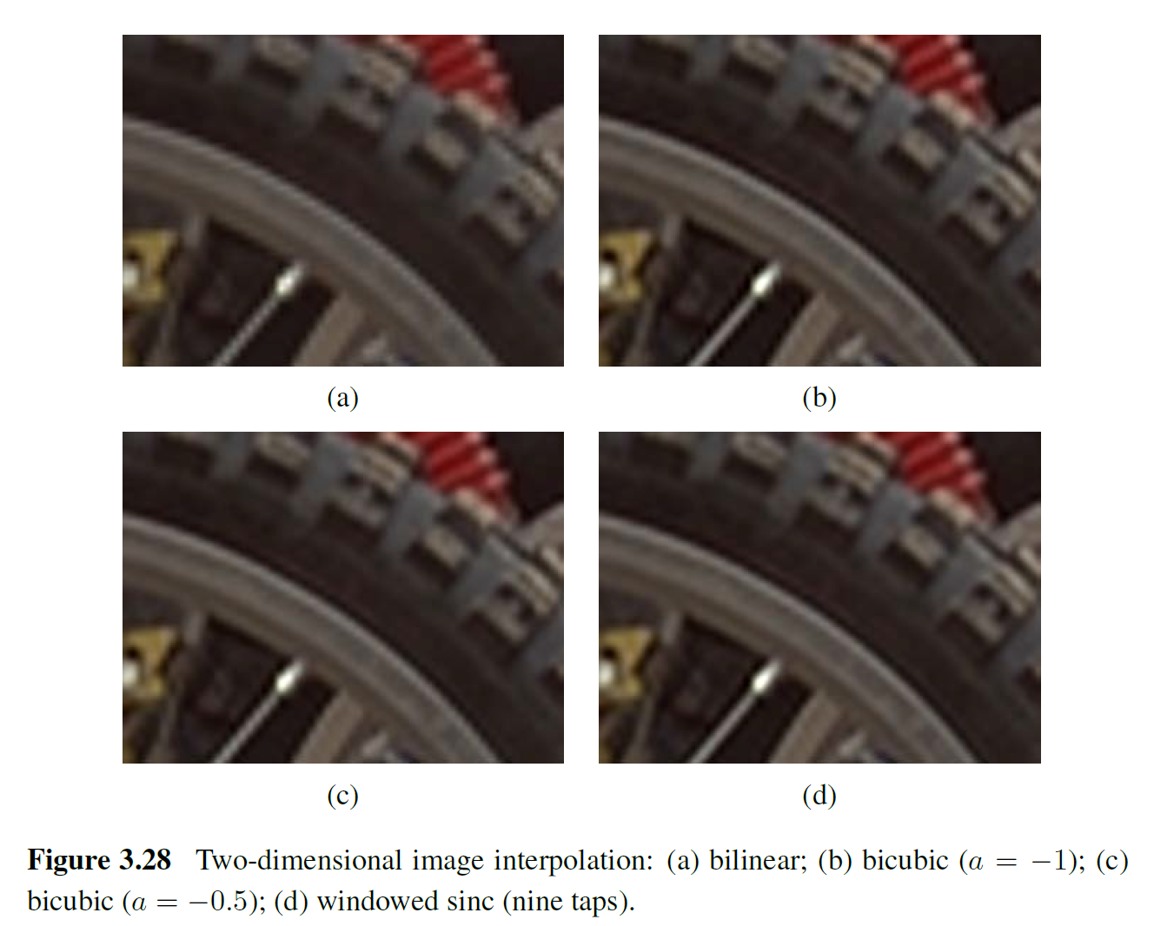
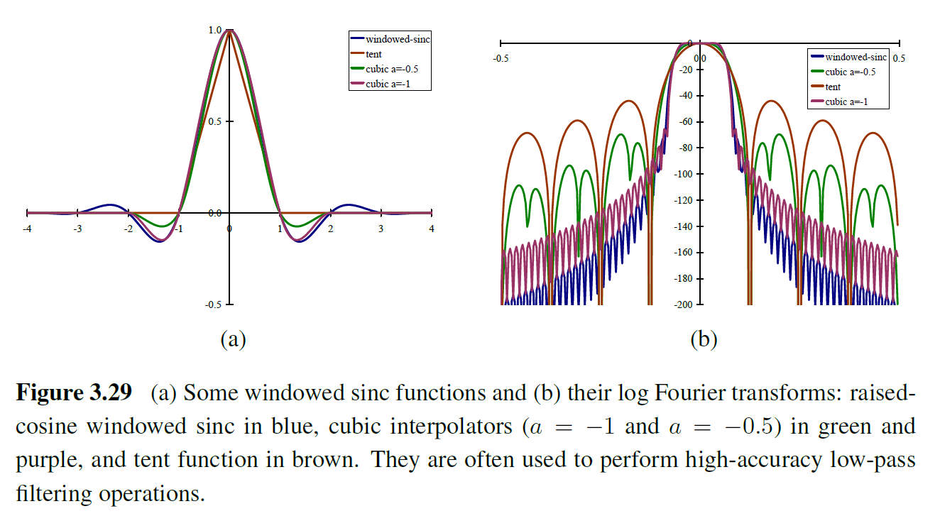
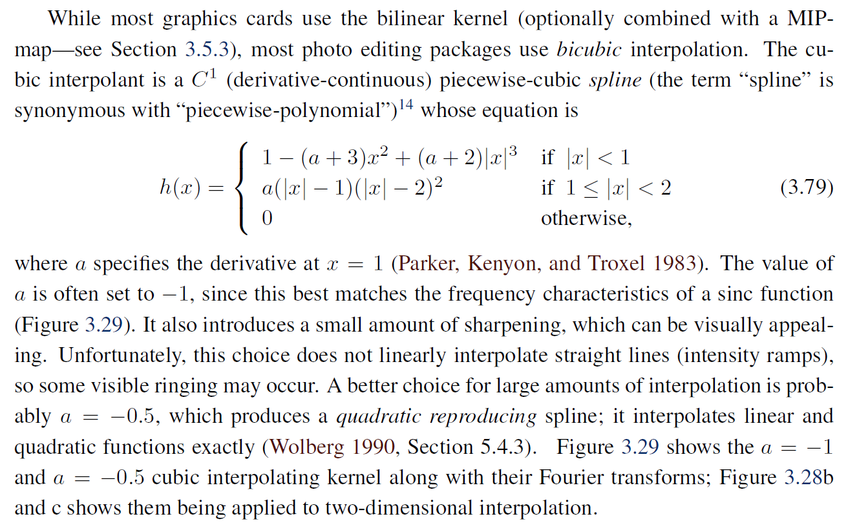
Interpolation – bicubic, windowed sinc
More advanced topic: super-resolution (Computational Photography lecture)

Slide 29
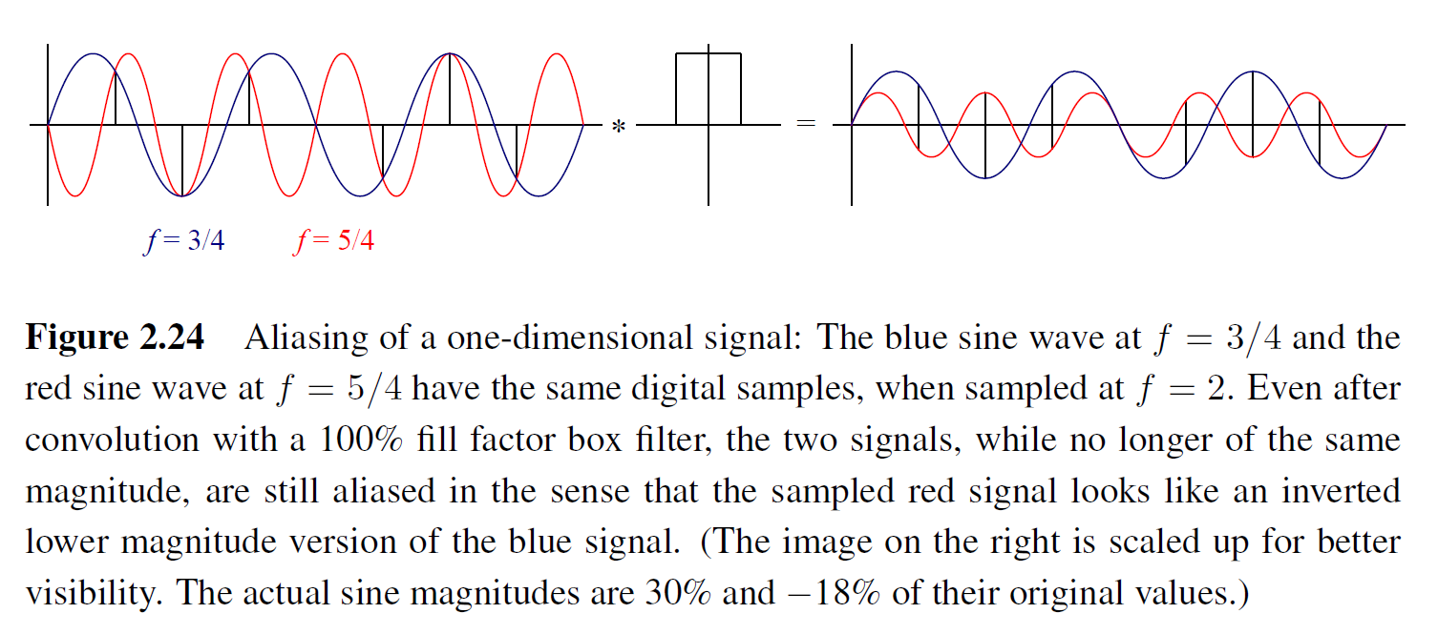
Aliasing

Slide 30
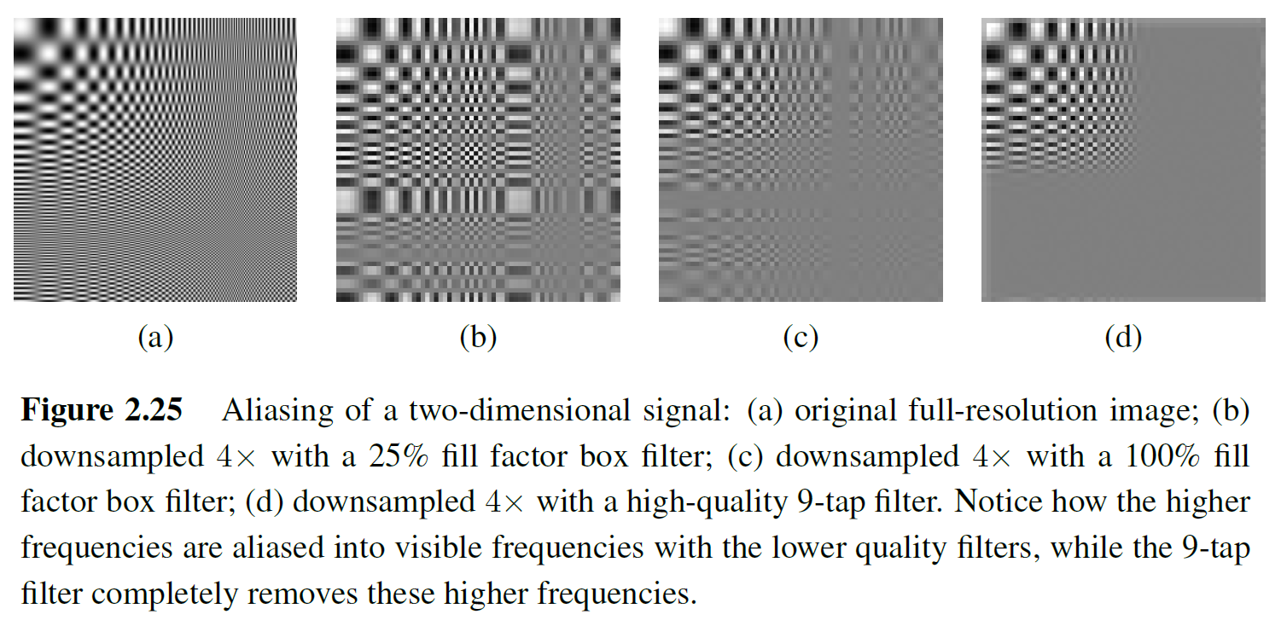
Aliasing

Slide 31
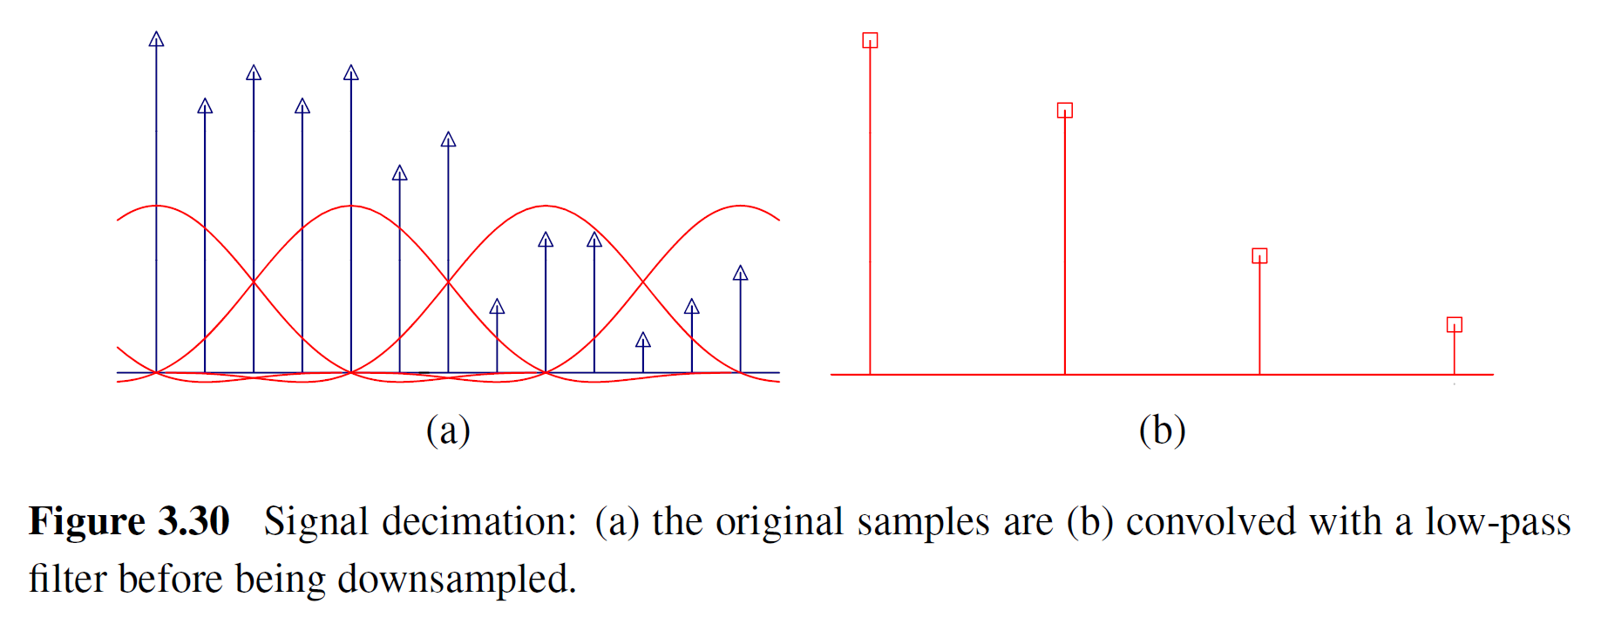
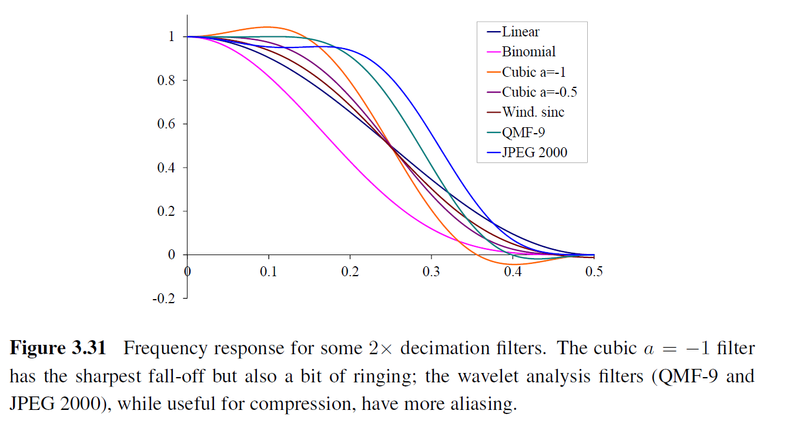
Decimation (downsampling)

Slide 32
Multi-resolution image pyramids
Commonly used in coarse-to-fine matching, optical flow, stereo, blending, …
… deep neural networks
Notes:
Anything else?

Slide 33
“Gaussian” pyramid
Uses “binomial” (not real Gaussian) downsampling kernel

Slide 34
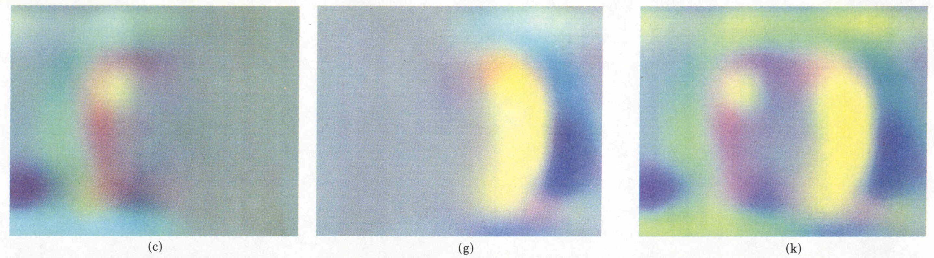
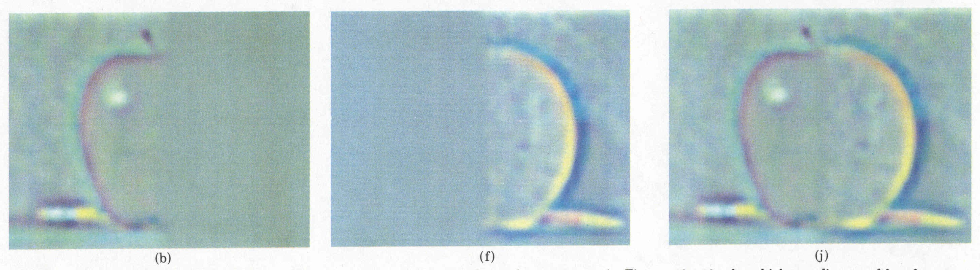
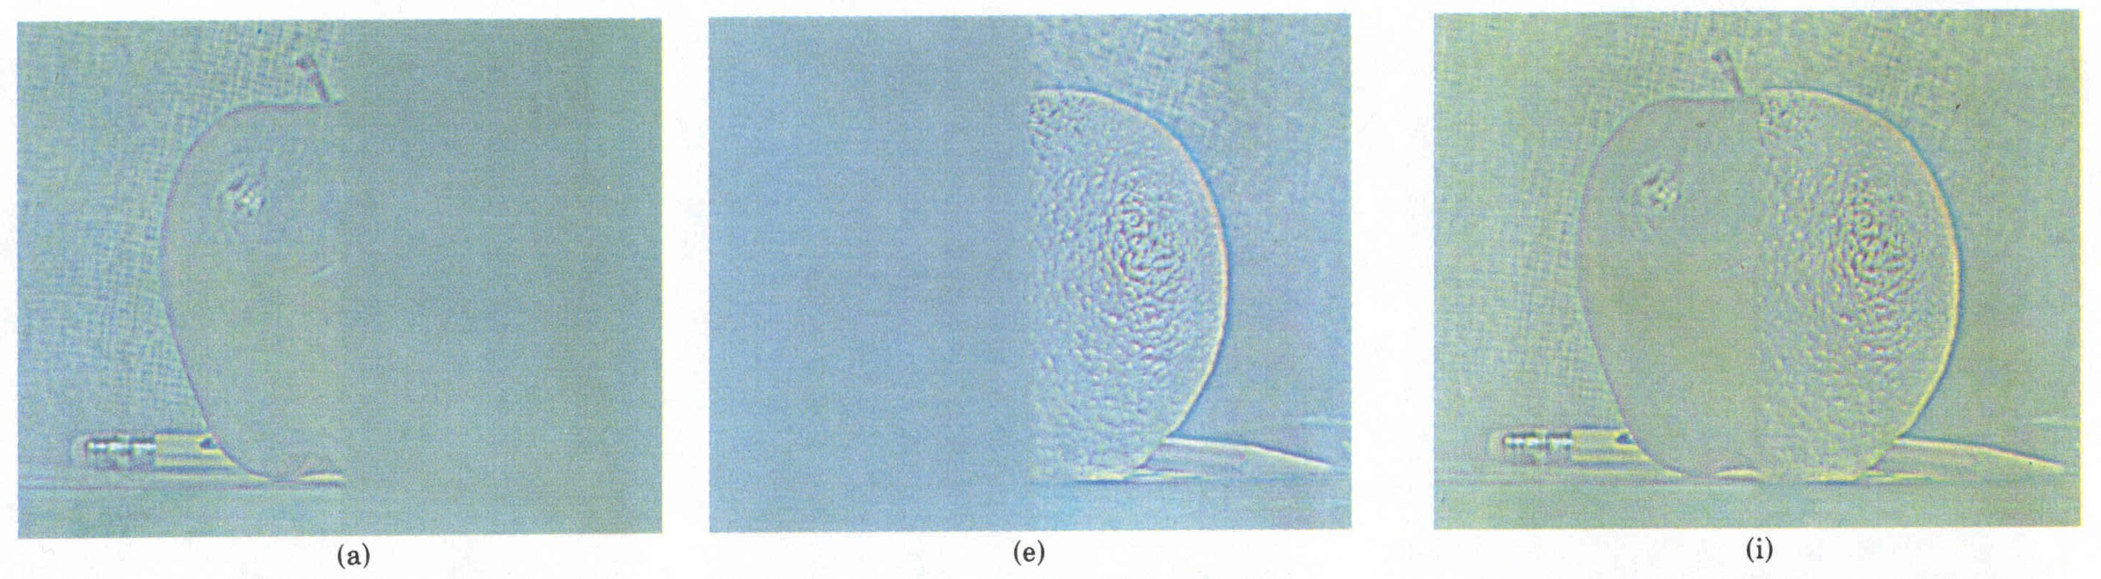
“Laplacian” pyramid
Laplacian
level
4
Burt & Adelson’s “Laplacian” is a difference of (interpolated) “Gaussians”
Laplacian
level
2
Laplacian
level
0
left pyramid
right pyramid
blended pyramid

Slide 35
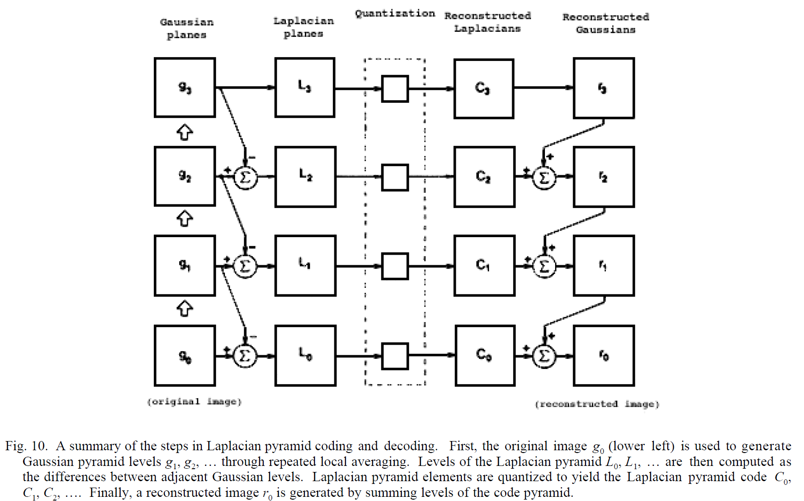
Laplacian pyramid coding (compression)

Slide 36
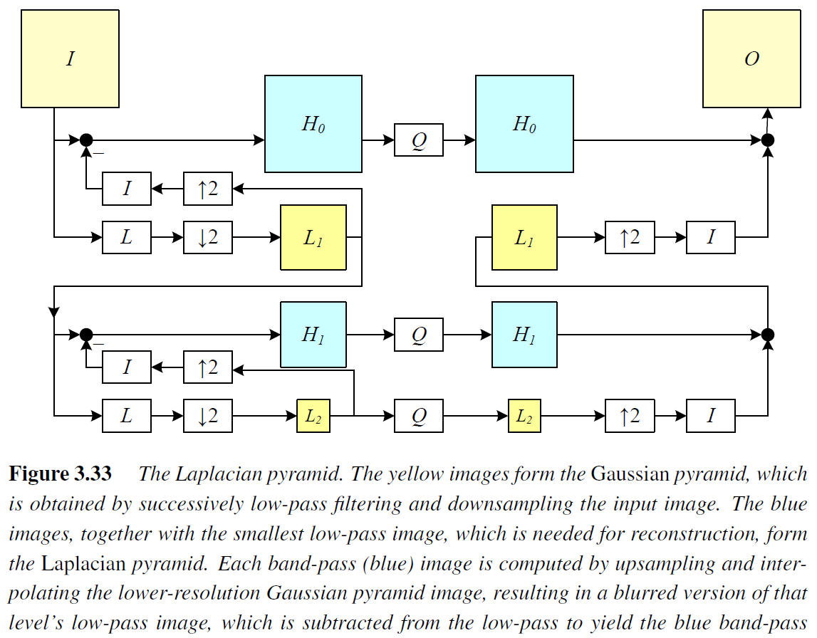
Laplacian pyramid

Slide 37
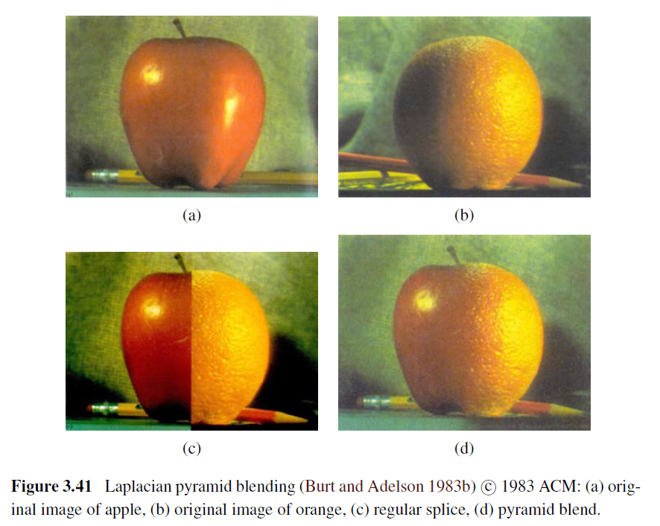
Laplacian pyramid blending

Slide 38
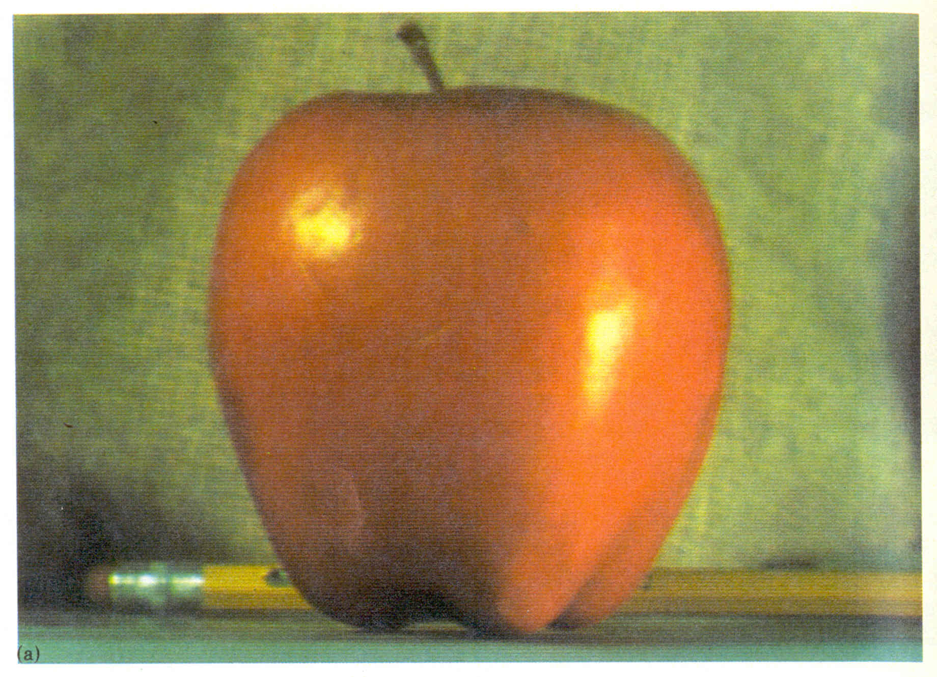
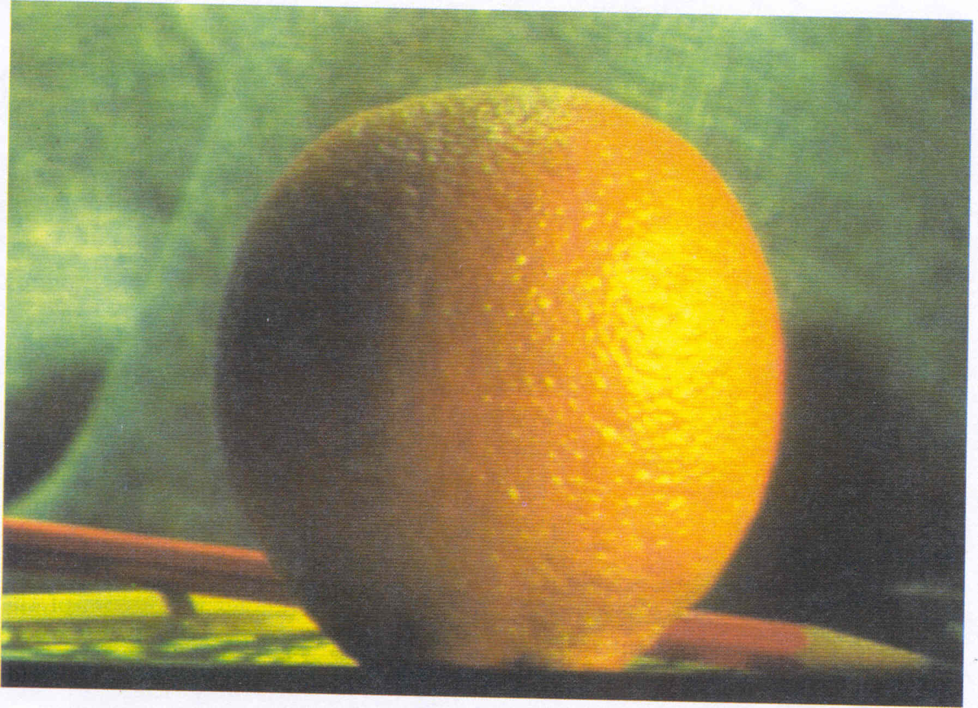
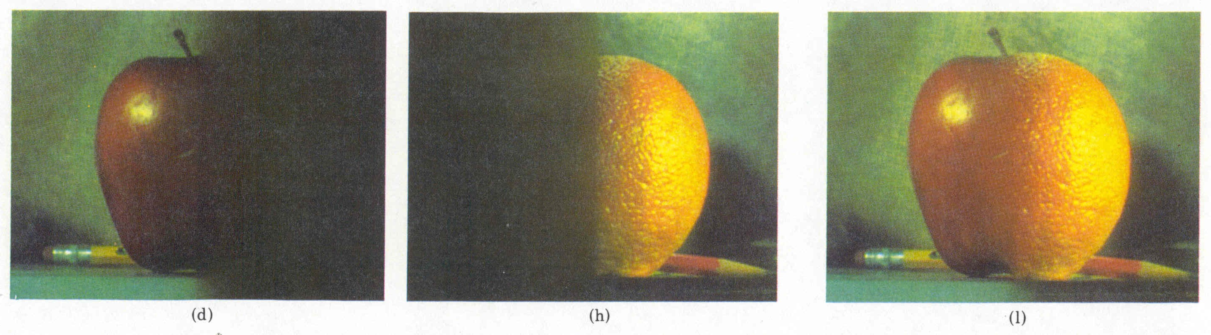
Pyramid Blending
Burt, P. J. and Adelson, E. H., A multiresolution spline with applications to image mosaics, ACM Transactions on Graphics, 42(4), October 1983, 217-236.

Slide 39
Laplacian
level
4
Laplacian
level
2
Laplacian
level
0
left pyramid
right pyramid
blended pyramid

Slide 40
Laplacian pyramid blending algorithm
Construct a Laplacian pyramid (base is Gaussian) for each input color (or grayscale) image
Construct a Gaussian pyramid for corresponding image masks
Multiply each Laplacian by its corresponding mask Gaussian
Sum up the weighted Laplacians and normalize (divide) by summed Gaussian weights at each pixel
Reconstruct the final image from the blended Laplacian pyramid

Slide 41


Laplacian pyramid blending

Slide 42
Interpolation and optimization
Interpolation
Pyramids
Blending
Resampling (rotations, etc.)
Data Fitting
Regularization and variational techniques
Markov Random Fields
Notes:
This is the actual content of Lecture 5 for CSE 576

Slide 43
Image warping
Geometric Transforms

Slide 44
Image Warping
image filtering: change range of image
g(x) = h(f(x))
image warping: change domain of image
g(x) = f(h(x))
f
f
h
x
x
f
f
h
x
x

Slide 45

Image Warping
image filtering: change range of image
g(x) = h(f(x))
image warping: change domain of image
g(x) = f(h(x))
f
g
h
f
g
h

Slide 46




Parametric (global) warping
Examples of parametric warps:
translation
rotation
aspect
perspective
affine
cylindrical
Notes:
Does anyone know how many degrees of freedom each one has?

Slide 47
2D coordinate transformations
translation: x’ = x + t x = (x,y)
rotation: x’ = R x + t
similarity: x’ = s R x + t
affine: x’ = A x + t
perspective: x’ ≅ H x x = (x,y,1) (x is a homogeneous coordinate)
These all form a nested group (closed w.r.t. inversion)
How many parameters for each one?
Notes:
Does anyone know how many degrees of freedom each one has?

Slide 48
Image Warping
Given a coordinate transform x’ = h(x) and a source image f(x), how do we compute a transformed image g(x’) = f(h(x))?
h(x)
x
x’
f(x)
g(x’)

Slide 49
Forward Warping
Send each pixel f(x) to its corresponding location x’ = h(x) in g(x’)
What if pixel lands “between” two pixels?
h(x)
x
x’
f(x)
g(x’)

Slide 50
Forward Warping
Send each pixel f(x) to its corresponding location x’ = h(x) in g(x’)
What if pixel lands “between” two pixels?
Answer: add “contribution” to several pixels, normalize later (splatting)
h(x)
x
x’
f(x)
g(x’)

Slide 51
Inverse Warping
Get each pixel g(x’) from its corresponding location x’ = h(x) in f(x)
What if pixel comes from “between” two pixels?
h(x)
x
x’
f(x)
g(x’)

Slide 52
Inverse Warping
Get each pixel g(x’) from its corresponding location x’ = h(x) in f(x)
What if pixel comes from “between” two pixels?
Answer: resample color value from interpolated (prefiltered) source image
x
x’
f(x)
g(x’)

Slide 53

Interpolation
Possible interpolation filters:
nearest neighbor
bilinear
bicubic (interpolating)
sinc / FIR (finite impulse resp.)
Needed to prevent “jaggies” and “texture crawl”

Slide 54

Prefiltering
Essential for downsampling (decimation) to prevent aliasing
MIP-mapping [Williams’83]:
build pyramid (but what decimation filter?):
block averaging
Burt & Adelson (5-tap binomial)
7-tap wavelet-based filter (better)
trilinear interpolation
bilinear within each 2 adjacent levels
linear blend between levels (determined by pixel size)

Slide 55

Prefiltering
Essential for downsampling (decimation) to prevent aliasing
Other possibilities:
summed area tables
elliptically weighted Gaussians (EWA) [Heckbert’86]

Slide 56

General mesh warping

Slide 57

Image morphing

Slide 58


Image morphing – Black or White video
https://www.youtube.com/watch?v=F2AitTPI5U0

Slide 59
Filtering, resampling, pyramids, blending
Linear and separable filtering
Non-linear filtering
Pyramids
Blending
Resampling (rotations, etc.)
Data Fitting
Regularization and variational techniques
Markov Random Fields

Slide 60
Data fitting and optimization

Slide 61



Slide 62
Scattered data interpolation / approximation
Green: original (clean) curve
Blue: noisy samples
Red: fitted curve
Interpolation or approximation?
Underfitting or overfitting?
Notes:
Ask for student ideas

Slide 63

More formally

Slide 64
Scattered data interpolation / approximation
Green: original (clean) curve
Blue: noisy samples
Red: fitted curve
Underfitting or overfitting?
What is it good for?
Notes:
Ask for student ideas

Slide 65

CVPR’19 NTIRE workshop talk
https://data.vision.ee.ethz.ch/cvl/ntire19/speakers/PeymanMilanfar_Computation_and_Photography.pdf

Slide 66



Modern Mobile Imaging: Burst Photography
Exposure control
Align
Merge
Enhance
Align: Reliable Optical Flow – Scene is never stationary
Merge: Artifact-free Fusion – Alignment failures, occlusion, ...
Enhance: Denoise, Sharpen, Contrast, Dynamic Range

Slide 67



Classic Camera Image Processing Pipeline
“Enhance”
“Merge”
Demosaic
Michael Brown

Slide 68


Demosaicing

Slide 69
Demosaicing …. Kills Details and Produces Artifacts

Slide 70
Instead ….. Replace demosaicing with multiple frames

Slide 71
Pixel shifting
1 | 1 | 1 | 1
1 | 1 | 1 | 1
1 | 1 | 1 | 1
1 | 1 | 1 | 1
1 |  |  | 1 |  | 1 |  | 1
 | 1 |  | 1 |  | 1 |  | 1
 | 1 |  |  | 1 |  | 1
 | 1 |  |  | 1 |  | 1

Slide 72
1 | 1 | 1 | 1
1 | 1 | 1 | 1
1 | 1 | 1 | 1
1 | 1 | 1 | 1
2 | 2 | 2 | 2
2 | 2 | 2 | 2
2 | 2 | 2 | 2
2 | 2 | 2 | 2
1 |  |  | 1 |  | 1 |  | 1
 |  | 2 |  | 2 |  | 2
 | 1 |  | 1 |  | 1 |  | 1
 |  | 2 |  | 2 |  | 2
 | 1 |  |  | 1 |  | 1
 |  | 2 |  | 2 |  | 2
 | 1 |  |  | 1 |  | 1
 |  | 2 |  | 2 |  |  | 2

Slide 73
1 | 1 | 1 | 1
1 | 1 | 1 | 1
1 | 1 | 1 | 1
1 | 1 | 1 | 1
2 | 2 | 2 | 2
2 | 2 | 2 | 2
2 | 2 | 2 | 2
2 | 2 | 2 | 2
3 | 3 | 3 | 3
3 | 3 | 3 | 3
3 | 3 | 3 | 3
3 | 3 | 3 | 3
1 |  |  | 1 |  | 1 |  | 1
3 |  | 2 | 3 | 2 | 3 | 2 | 3
 | 1 |  | 1 |  | 1 |  | 1
3 |  | 2 | 3 | 2 | 3 | 2 | 3
 | 1 |  |  | 1 |  | 1
3 |  | 2 | 3 | 2 | 3 | 2 | 3
 | 1 |  |  | 1 |  | 1
3 |  | 2 | 3 | 2 | 3 |  | 2
How do you merge these samples and fill in the missing data?

Slide 74




Merge: Nonlinear Kernel Regression
Continuous interpolation
Kernel functions
Measurements

Slide 75
How can we interpolate scattered data?

Slide 76

Triangulations and pyramids

Slide 77

Underfitting and overfitting

Slide 78

Underfitting and overfitting

Slide 79

Bias / variance tradeoff

Slide 80

Curve fitting
https://xkcd.com/2048/ © 2018 Randall Munroe

Slide 81
L2 interpolation / approximation
Notes:
What are alternatives to L2 interpolation

Slide 82

Robust fitting – dealing with outliers

Slide 83
Controlled continuity surface fitting
Notes:
What are examples of discontinuities in visual processing?
How can we model discontinuities in our reconstructions?

Slide 84

Variational methods

Slide 85

Controlled continuity splines

Slide 86



Discrete energy minimization
Notes:
Can think of this as a resistive grid, where the s and cs are conductances and ds and fs are input and output voltages
What kind of a system is this? How can we solve it?

Slide 87

Interactive edge-preserving colorization
Notes:
Can you “spot” the difference between the original image (right) and the colorized grayscale (middle)?

Slide 88

Speeding up the solver

Slide 89

Hierarchical basis preconditioning

Slide 90

Robust regularization

Slide 91


Bilateral solver
(future lecture)?

Slide 92
Interpolation and optimization
Interpolation
Pyramids
Blending
Resampling (rotations, etc.)
Data Fitting
Regularization and variational techniques
Markov Random Fields
Notes:
This is the actual content of Lecture 5 for CSE 576

Slide 93

Markov Random Fields

Slide 94

Why Bayesian (probabilistic) modeling?
Merge uncertain measurement in an optimal way
Estimate the uncertainty in the final answer
Build in (quantitative) prior assumptions

Slide 95
Example: merge GPS readings
Measurement 1: 10.1 ± 0.1667 (1/6) Gaussian noise
Measurement 2: 10.2 ± 0.1250 (1/8) Gaussian noise
What is the optimal combined measurement?
Exercise for next lecture
(send me your answer on Slack)
10.0 10.1 10.2 10.3 10.4
Notes:
Additional (ungraded) exercise, will become important next lecture

Slide 96

Why a Bayesian formulation?
Wider range of probability distributions
Learn distributions from data
Wider range of inference algorithms [Kappes, Andres, et al., IJCV 2015]

Slide 97

Energy minimization

Slide 98

Digital Photomontage

Slide 99
Markov Random Fields

Slide 100


Conditional Random Fields
Interaction potentials depend on guide image (sound familiar?)

Slide 101

Dense CRF [Krähenbühl and Koltun 2011]
Use a wide color-based support region (like bilateral solver)

Slide 102
Wrapping up
Interpolation
Pyramids
Blending
Resampling (rotations, etc.)
Data Fitting
Regularization and variational techniques
Markov Random Fields
Notes:
This is the actual content of Lecture 5 for CSE 576

